Slide 1
Human Centred Design 101: Prototyping and interviewing tips

Slide 2
Different types of prototypes
Paper prototype
Can be a rough sketch of an idea on paper.
Fastest way to explore ideas and encourages changes.
Low Fidelity prototype
A simple digital with basic function, it can be clickable to show function.
Testing: navigation and task completion
High Fidelity prototype
A more detailed and polished version that looks close to a final product.
This helps us test usability with realistic content.
Functional prototype
Something that functions like a real thing, if it is a digital product, it might be a partially functioning code prototype.

Slide 3
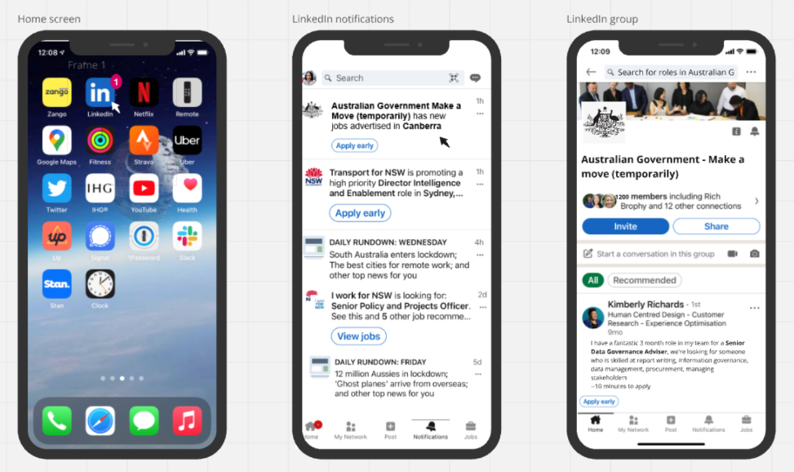
Paper prototype
Scenario: You're a seasoned governance and program management professional in the Australian Public Service (APS) and you have recently completed training in data analytics. You like your current role, but you would like to get some hands on experience on the topic your training covered.

Slide 4
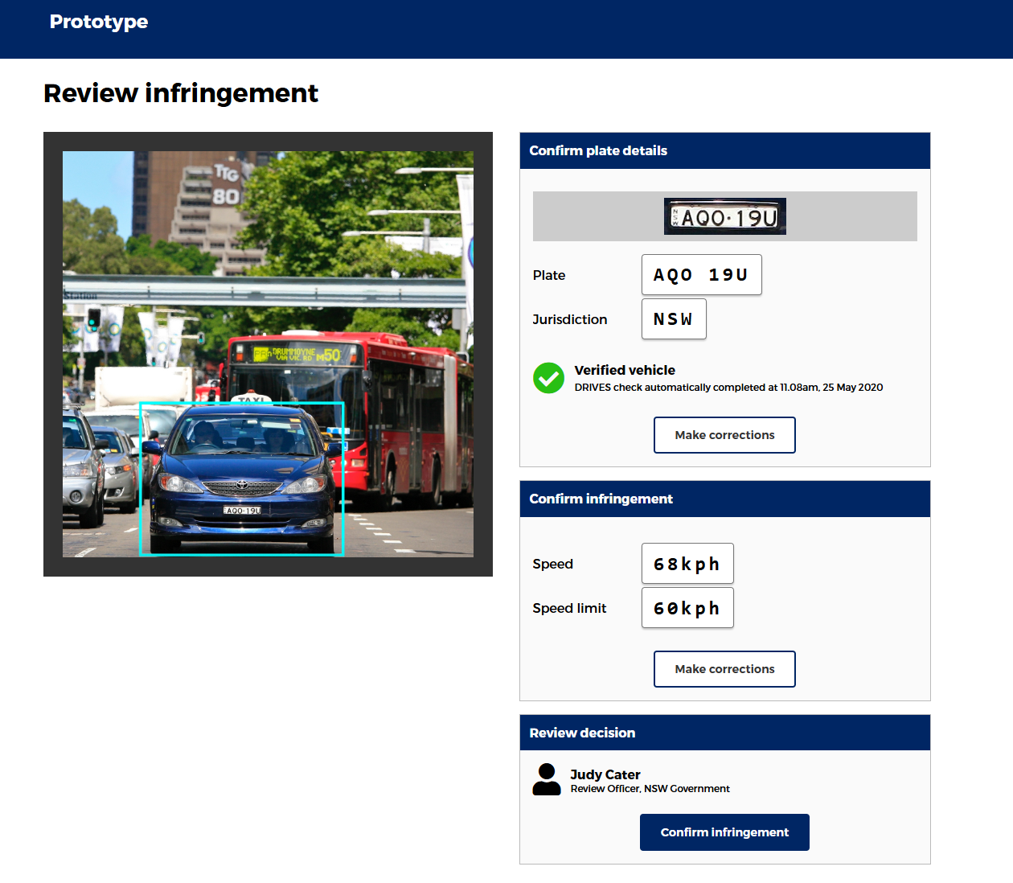
Low fidelity clickable prototype
Problem: Hundreds of people manually checking camera footage and then issuing fines. This work is tedious and highly prone to error as a result and must pass through multiple hands to check accuracy. People are also entitled to waivers for good behaviour but aren't currently offered them.
Prototype: My team used open source software to develop a proof of concept for an automated number plate recognition system pilot to see if it was possible. We developed prototypes for how this might work for staff so there would be human oversight but the work would be quicker and easier.
See an example low fidelity prototype for the staff experience:
View this low fidelity clickable code prototype

Slide 5
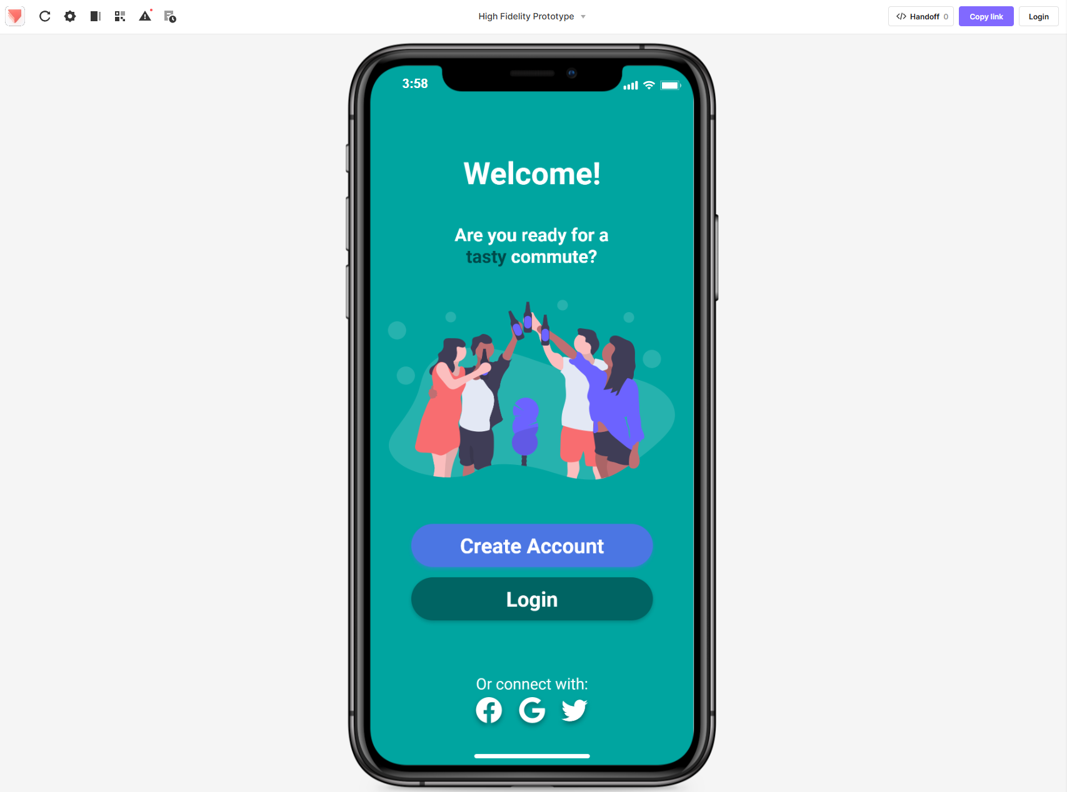
High fidelity clickable prototype
Take a look at this higher fidelity clickable prototype:
A high fidelity clickable prototype to help people find tasty meals near them.

Slide 6
Functional prototype
Wizard of Oz style functioning prototype
Description: A Wizard of Oz test is when a service looks real and automated to a customer, but is performed
manually on the back end. There are usually at least some functional, automated parts of the system but
some tasks that are done by a person.
The Zappos story:
The most well-known example of a Wizard of Oz test is from Zappos.
When Zappos first started in the late 90s, they weren’t sure if anyone would actually buy shoes online.
To test this hypothesis, they built a front end website for customers to order shoes, but then the Zappos owner would go to a local store and buy the shoes and ship them for every order.
This way they didn’t have to buy stock in advance, or build an inventory systems until they’d proven they could sell enough shoes to justify the expense of creating those systems and buying the stock in bulk.

Slide 7
Showing your prototype
Set the scene about the prototype/s
Talk through your scenario
Don't 'sell it' the solution to them and don't explain how it works to them
Just set the context about the problem - who might use it and when
You want them to do most of the talking, best interviews are when you say very little
Show the thing!
Share your screen so they can see the prototype. Don't move too quickly, so they can think and talk out loud about what they're seeing.
Note taker can take notes under the prototype.
If they ask a question about how it works, ask them how they would expect it to work.
Once they've talked thought what they've seen - dig deeper with a few extra questions.

Slide 8
Think out loud exercise explanation template
Script for the interview
Have you ever seen a ‘prototype’ before?
They’re a way to present and explore a concept
They’re very rough, you’ll have to fill in the gaps for us in some places, and talk us through what you’d expect to happen next
You’ll see we’ve done just enough to help us have a conversation and understand any expectations, problems or opportunities you see
They’re developed just enough to get your thoughts, and test whether it’s worth spending more time developing further, or if we should try something different
So, I’m going to show you a few concepts now, and ask you to:
Talk out loud about what you see, what your thoughts are
Talk me through what you’d expect it to mean, what you’d think would happen next
Identify anything you find confusing or difficult, anything that doesn’t make sense or anything unexpected
How to use this template
Use the script when you’re testing prototypes with people. Its not easy as a participant to ‘think out loud’ and the concept of a rough prototype isn’t always easy for people to consume.

Slide 9
Quick tips on interviewing users
Provide enough context so they understand it’s purpose
Let them know it’s a work in progress
Avoid selling or explaining how your idea works
Invite participants to treat your rough prototype as if they were real
Ask them to think out loud
Be curious – if they say no, why not? If they say yes, in what situation?
If they have a question :like ‘how would this work?’), ask in return ‘how would you expect it to work?’
Seek feedback: What doesn’t work for you? How would you improve it? If you could change one thing, what would it be?
Be aware of your own body language and facial reactions
Be ready to iterate

