Slide 1
Issues tree guide
A structured way to break problems down and plan work

Slide 2

Issues trees are one way to break a problem down
Start with your overall problem question
?
Develop sub-questions by asking,
‘What do we need to know to be able to answer the larger question?’
Questions should:
have ‘no gaps, no overlaps’ at each level
be MECE – Mutually Exclusive, Completely Exhaustive, both vertically and horizontally

Slide 3
There are different ways to structure issues trees
Current situation
Sector / discipline
Question
Question
Complications
Sector / discipline
Resolution
Sector / discipline
A narrative structure is useful for logically breaking down the problem and guiding future products.
This approach can be useful for breaking down a problem that affects sectors in different ways.
Supply
Cohort / location
Question
Question
Demand
Cohort / location
Levers
Cohort / location
Taking an economic lens can help by breaking problems into supply, demand and levers.
Structuring based on cohorts or location can reveal the full scale of a problem’s impacts.

Slide 4
An example from the Ice Taskforce
  How is ice imported in to Australia, and how much?
This issues tree uses the Situation, Complication, Resolution structure.
  How is ice produced in Australia, and how much?
  How is ice distributed throughout Australia?
SITUATION
  Who consumes ice in Australia, and how much?
How is ice produced, distributed and consumed in Australia?
  Where are the gaps in our knowledge?
  How is ice usage changing?
  How is ice impacting individuals?
How is ice impacting individuals and the community in Australia?
  How is ice impacting communities?
How can governments reduce the use of ice and its impact on individuals and communities?
  How is ice impacting other groups e.g. first responders?
  What are community and expert views on ice?
What is currently being done to reduce ice and its impacts?
  What other evidence and research on ice is there?
  What is the Commonwealth doing?
  What are the States and Territories doing?
  What are local and non-government actors doing?
COMPLICATION
  What are other countries doing?
How appropriate, effective and efficient are our existing efforts, and how can they be improved?
  How do we measure the success of an effort?
  What efforts are working?
  What efforts can be more efficient and/or effective?
RESOLUTION
  What efforts overlap and/or be better coordinated?
What new approaches and strategies could reduce ice and its impacts?
  What efforts should be retargeted/reformed?
  Are major changes required to existing approaches?
  Are there any new initiatives or efforts required?

Slide 5
Issues tree – template
Overarching question…

Slide 6
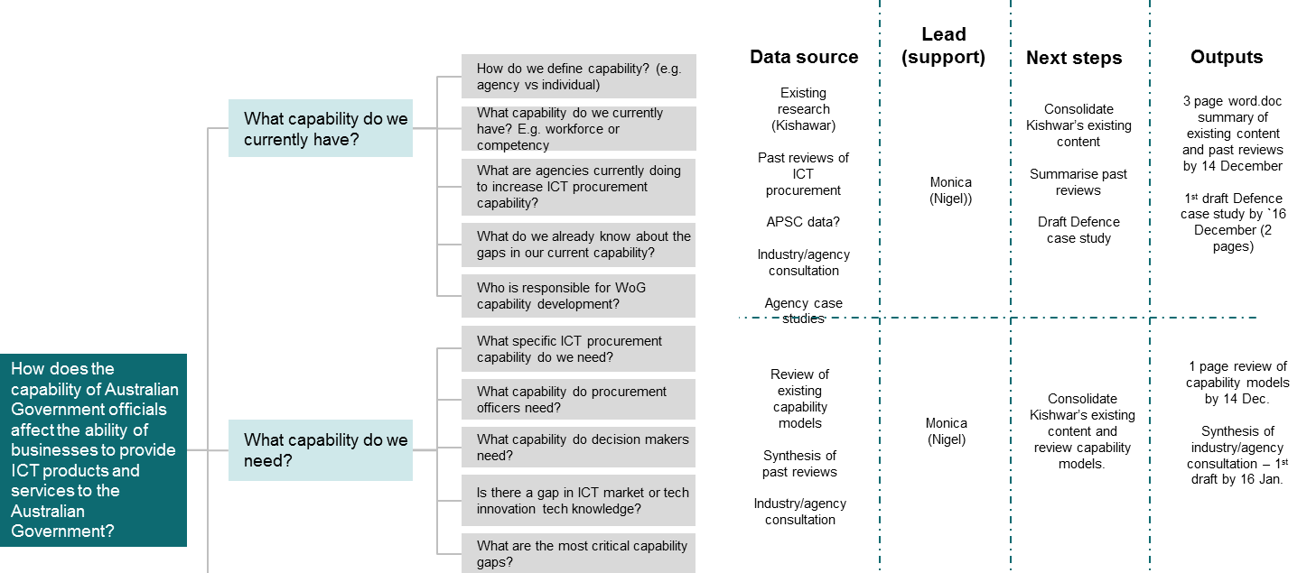
Use your issues tree to plan your research and stakeholder engagement
For each branch of the issues tree, identify the data you need to answer each question – this may include policy papers, academic journals, white papers, end users and experts. This can be used to plan who you need to consult with and when.
Each branch should also lead to a tangible output for the taskforce’s work – such as research summaries, case studies, report chapters or policy proposals.

Slide 7
Your issues tree can also guide your key deliverables
  What is the Commonwealth doing?
What is the current state of play for access to public sector data?
  What are states and territories doing?
Deliverable 1:
Scoping paper
    What is happening internationally?
  What are the costs and barriers?
What are the costs and benefits of opening access to public sector data?
  What are the benefits of opening access to public sector data for the government and private sectors?
Deliverable 2:
Issues paper
How can Australia realise the benefits of opening access to public sector data (with appropriate privacy safeguards) to drive innovation, efficiency, productivity and economic growth?
  How can it contribute to government efficiency and effectiveness?
Deliverable 4:
Final report and recommendations
  What is Australia’s short and long term objective?
  What does a staged road map look like?
Deliverable 3:
Possible reform directions
How to realise the potential of opening access to public sector data, while safeguarding privacy?
    How to develop an APS culture to better use and open access to public data?
  How do we ensure a sustained, citizen-centric focus?
  What protections need to be in place when opening access to public data?
How to engage the public and build trust in public sector data?
  How can we reassure citizens that their personal information is safe?
  How can we explain the benefits of accessible public data?

